Slide 1
Bury GP Federation
Building a GP Federation and delivering change
Sheffield Primary Care Development Event
26th October 2017

Slide 2
Bury GP Federation
A brief history and our current approach
Martin Clayton
Chief Executive

Slide 3
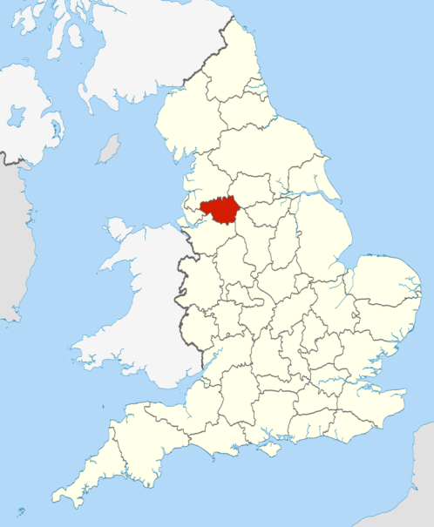
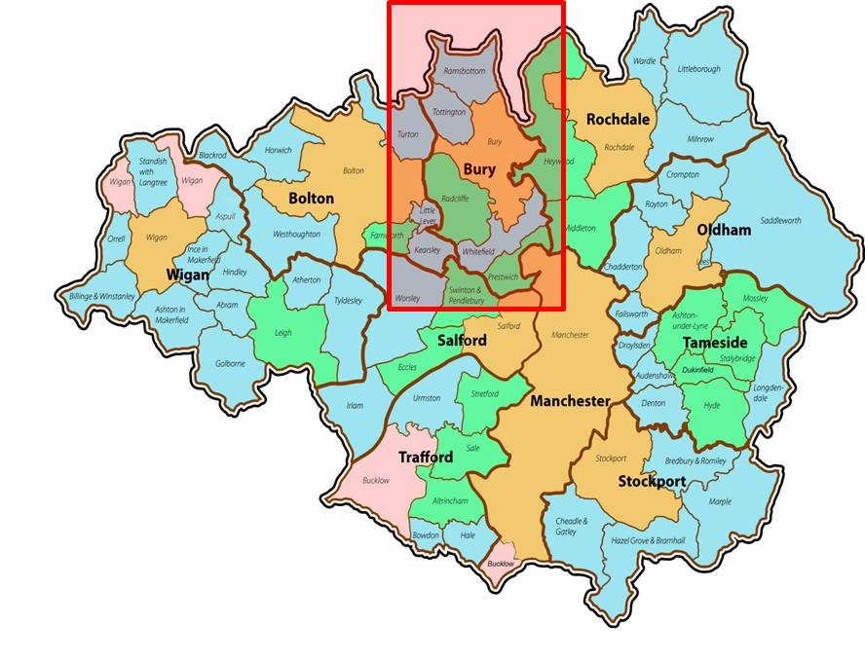
Bury – Greater Manchester

Slide 4
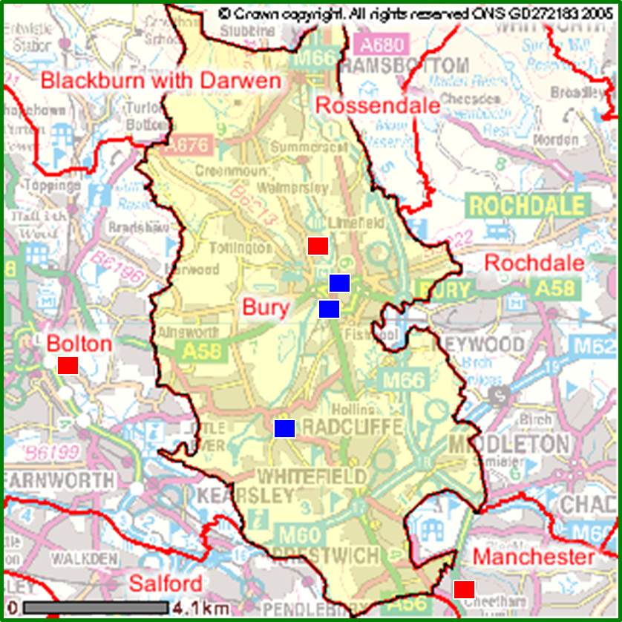
Bury – Greater Manchester
200,000 population
30 GP practices
3 large Primary Care Centres
Surrounded by acute hospitals

Slide 5
Why Federate? What are the issues Primary Care face
New contract demands
Increased integration with other providers
“Corner shop” model has to change
Move care & new services into the community
Keep patients out of hospital
Commission from one provider
Keep funding within Primary Care
Everyone doing everything! – not sustainable

Slide 6
What? Original intentions - 2011
Deliver more cost-effective services across our practices
Joint procurement
Mutual services
Payroll
Practice management
Mutual practice support
Delivering more services in general practice, e.g.
Community services
anticoagulation

Slide 7
What? Development phase
Shareholder conditions:
Loan per head registered population = 99p
Share cost per registered patient = 1p
Sign-up to shareholder agreement
Non-competition clauses
26 practices took shareholdings initially
Range from 2,000 to 10,500
Company acquired £156,000 in loan capital
Currently 28 of 30 practices are in the Federation
…other 2 looking to join

Slide 8
What? Development Phase
Structure:
Final structure agreed – September 2012
Company registered at Companies House in November 2012
Initial Board February 2013
Board Revised 2014
Board structure remains under review

Slide 9
FYFV & Partnerships - Vision
Five Year Forward View published October 14
Outline for how we need to do things differently and test different models
Future founded on list-based general practice but ………..
Foundation Trusts eager to engage with/acquire general practices – some motivated by appetite to improve integration – some by desire to expand to protect their future in an increasingly competitive and cost-constrained market
Alliances, joint ventures and partnerships likely to deliver more equal relationships and long term security than ownership

Slide 10
FYFV & Partnerships in practice
Developing more locally commissioned services
Developing more integrated approach to services through our Locality Care Organisation (equivalent of Sheffield Accountable Care Partnership)
Delivering into localities and neighbourhoods but necessary for these to be organisational entities
Federation shareholders delegated authority to negotiate local services on their behalf – commissioners agree only to negotiate with Federation and not individual practices
Shareholders agreed power to expel others not actively engaging

Slide 11
Lessons we’ve learned
It’s a Company not a practice!
Shareholders own but don’t do day-to-day running
On going active engagement and communication with shareholders vital, but
EVERYONE knows how to do it better, you need tough skin
Nationally there is a real appetite to support change
What we’re doing is only a start. We need to extend the range of available services significantly
The purpose and direction of the Federation will need to adapt over time
There really is competition for your services out there
Size does matter!!

Slide 12
Bury GP Federation
m.clayton@burygpfederation.co.uk

